Slide 1
Extra Material for P0W2D4

Slide 2
P0 W2 D4 PM

Slide 3
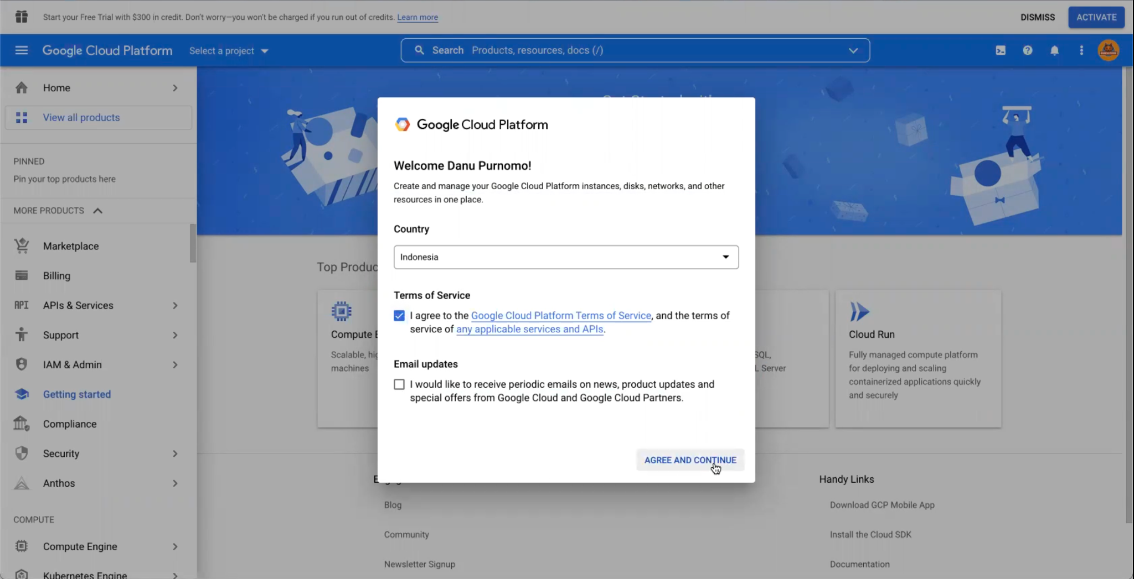
Getting Started
Login https://www.google.com/ with your Google account
Go to https://console.cloud.google.com/

Slide 4
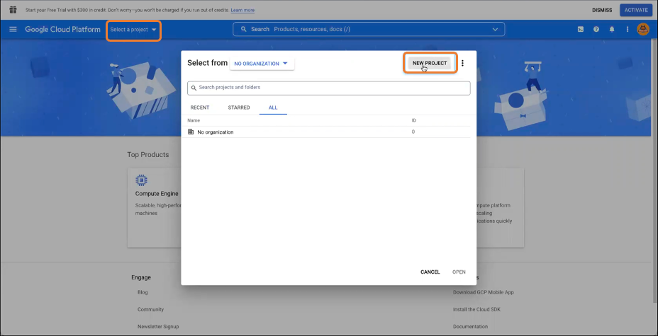
Create a New Project (1)

Slide 5
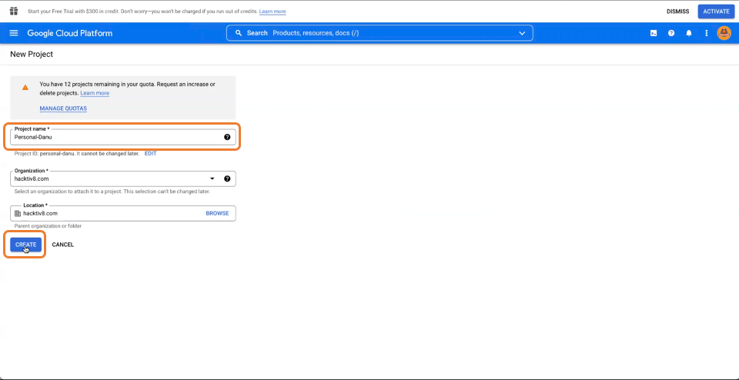
Create a New Project (2)

Slide 6
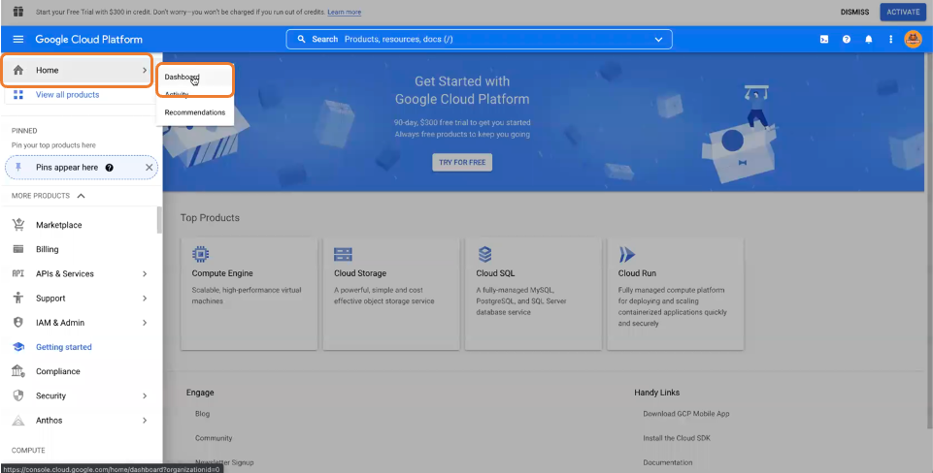
Go into Your Project (1)

Slide 7
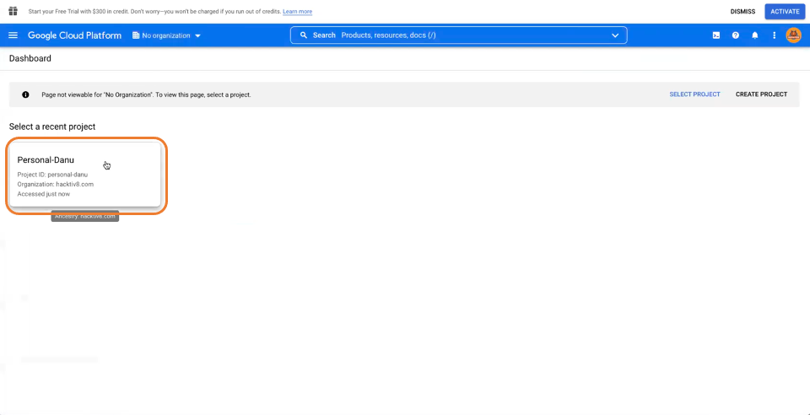
Go into Your Project (2)

Slide 8
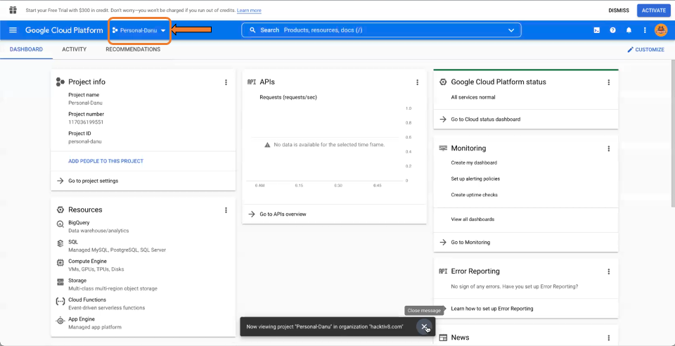
Go into Your Project (3)

